Slide 1


Michael Haldeman
Aug 2023

Slide 2

Outline
Executive Summary
Introduction
Methodology
Results
Conclusion
Appendix

Slide 3
Executive Summary
Summary of methodologies
Data Collection through API
Data Collection with Web Scraping
Data Wrangling
Exploratory Data Analysis with SQL
Exploratory Data Analysis with Data Visualization
Interactive Visual Analytics with Folium
Machine Learning Prediction
Summary of all results
Exploratory Data Analysis result
Interactive analytics in screenshots
Predictive Analytics result

Slide 4
Introduction
Project background and context
Space X advertises Falcon 9 rocket launches on its website with a cost of 62 million dollars; other providers cost upward of 165 million dollars each, much of the savings is because Space X can reuse the first stage. Therefore, if we can determine if the first stage will land, we can determine the cost of a launch. This information can be used if an alternate company wants to bid against space X for a rocket launch. This goal of the project is to create a machine learning pipeline to predict if the first stage will land successfully.
Problems to find answers for
What factors determine if the rocket will land successfully?
The interaction amongst various features that determine the success rate of a successful landing.
What operating conditions needs to be in place to ensure a successful landing program.

Slide 5

Section 1

Slide 6
Methodology
Executive Summary
Data collection methodology:
Data was collected using the SpaceX API and web scarping
Perform data wrangling
One-hot encoding was applied to categorical features
Perform exploratory data analysis (EDA) using visualization and SQL
Perform interactive visual analytics using Folium and Plotly Dash
Perform predictive analysis using classification models
How to build, tune, evaluate classification models

Slide 7
Data Collection
Methods used for data collection
Through the get request of the SpaceX API
Then turned the data from a json file to a pandas dataframe
Web scraped data from Wikipedia for Falcon 9 launches using BeautifulSoup
Converted the launch records unto a pandas dataframe to preform analysis
Once formed into a dataframe, the data was cleaned by replacing missing values

Slide 8
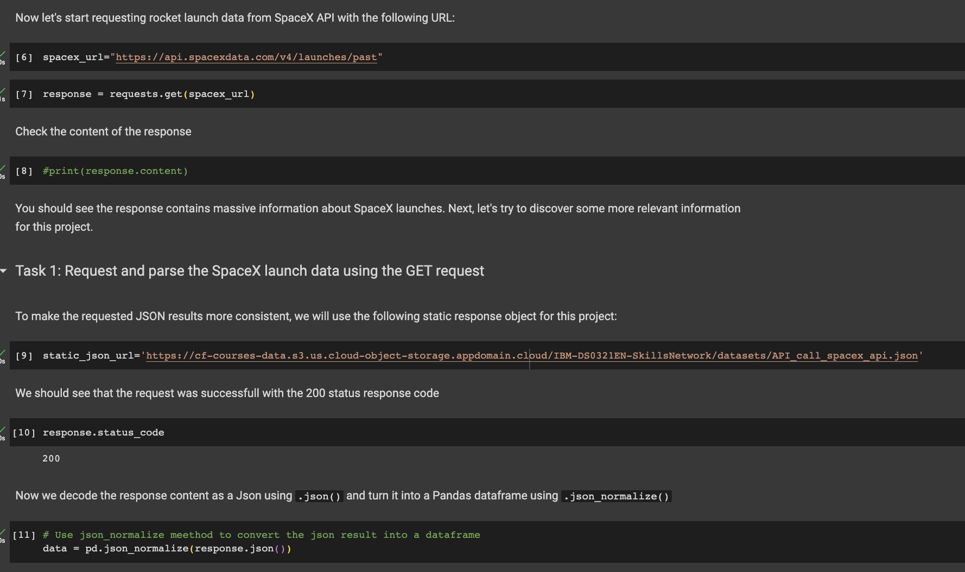
Data Collection – SpaceX API
We used the get request to the SpaceX API to collect data, clean the requested data and did some basic data wrangling and formatting.
The link to the notebook is https://github.com/Mike-Haldeman30/Data-Science-Capstone-Project/blob/main/jupyter-labs-webscraping.ipynb

Slide 9
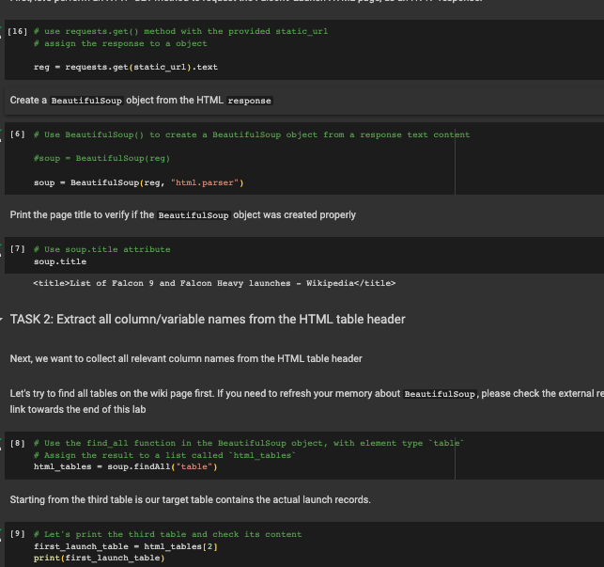
Data Collection - Scraping
Applied web scarping methods to obtain Falcon 9 launch records using BeautifulSoup
Converted the raw data into a pandas dataframe
The link to the notebook is https://github.com/Mike-Haldeman30/Data-Science-Capstone-Project/blob/main/jupyter-labs-webscraping.ipynb

Slide 10

Data Wrangling
We performed exploratory data analysis and determined the training labels.
We calculated the number of launches at each site, and the number and occurrence of each orbits
We created landing outcome label from outcome column and exported the results to csv.
The link to the notebook is
https://github.com/Mike-Haldeman30/Data-Science-Capstone-Project/blob/main/IBM_DS0321EN_SkillsNetwork_labs_module_1_L3_labs_jupyter_spacex_data_wrangling_jupyterlite_jupyterlite.ipynb

Slide 11
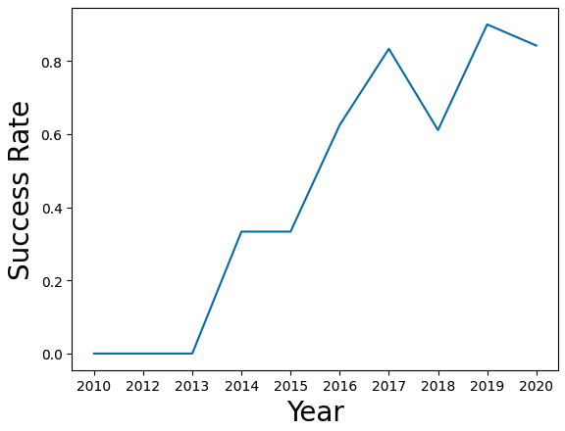
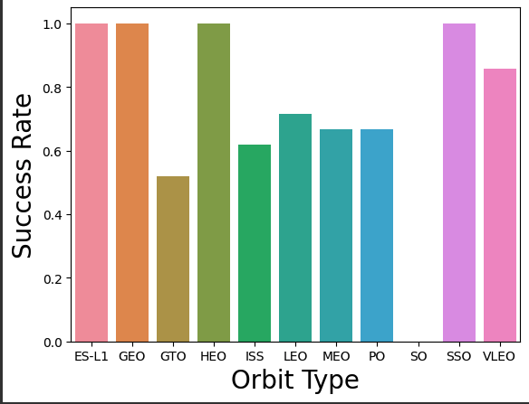
EDA with Data Visualization
Explored the data by graphing various combinations of variables to see correlation to each other. Such as Flight Number, Launch Site, payload, success rate of each orbit type, and orbit type
Notebook link
https://github.com/Mike-Haldeman30/Data-Science-Capstone-Project/blob/main/IBM_DS0321EN_SkillsNetwork_labs_module_2_jupyter_labs_eda_dataviz_ipynb_jupyterlite.ipynb

Slide 12
EDA with SQL
Uploaded the SpaceX dataset to a PostgreSQL database within a Jupyter Notebook
Applied EDA using SQL magic to obtain insights into the data
Answered several questions such as
The names of unique launch sites in the space mission.
The total payload mass carried by boosters launched by NASA (CRS)
The average payload mass carried by booster version F9 v1.1
The total number of successful and failure mission outcomes
The failed landing outcomes in drone ship, their booster version and launch site names.
The link to the notebook https://github.com/Mike-Haldeman30/Data-Science-Capstone-Project/blob/main/jupyter-labs-eda-sql-coursera_sqllite.ipynb

Slide 13
Build an Interactive Map with Folium
Using Folium, marked all launch sites, and added objects such as markers, circles, and lines to mark the class of launch from each site
Created a feature variable to show in color the different launches success rate on the map
Using the feature variables we were able to show which launch sites had a high success rate
The link to the notebook is https://github.com/Mike-Haldeman30/Data-Science-Capstone-Project/blob/main/IBM_DS0321EN_SkillsNetwork_labs_module_3_lab_jupyter_launch_site_location_jupyterlite.ipynb

Slide 14
Build a Dashboard with Plotly Dash
Built an interactive dashboard with Plotly Dash
Plotted a pie chart and scatter plot to show different variables interacting based upon launch site
The plotted pie chart showing the total launches by a certain sites
The plotted scatter graph showing the relationship with Outcome and Payload Mass (Kg) for the different booster version.
The link to the notebook is https://github.com/Mike-Haldeman30/Data-Science-Capstone-Project/blob/main/spacex_dash_app%20(1).py

Slide 15
Predictive Analysis (Classification)
Uploaded the dataset using pandas, and transformed the data, split up the data into training and test sets
Build different machine learning models and tuned each model from different hyperparameters using GridSearchCV
Used accuracy scoring as the metric for judging the performance of the model
Compared all created models and selected the best performing model
The link to the notebook is https://github.com/Mike-Haldeman30/Data-Science-Capstone-Project/blob/main/IBM_DS0321EN_SkillsNetwork_labs_module_4_SpaceX_Machine_Learning_Prediction_Part_5_jupyterlite.ipynb

Slide 16
Results
Exploratory data analysis results
Interactive analytics demo in screenshots
Predictive analysis results

Slide 17

Section 2

Slide 18
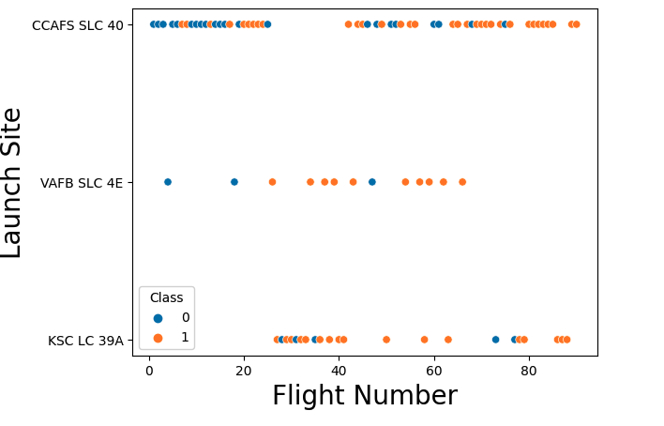
Flight Number vs. Launch Site
From the plot, it can be seen that the higher the Flight Number the more successful the landing is

Slide 19
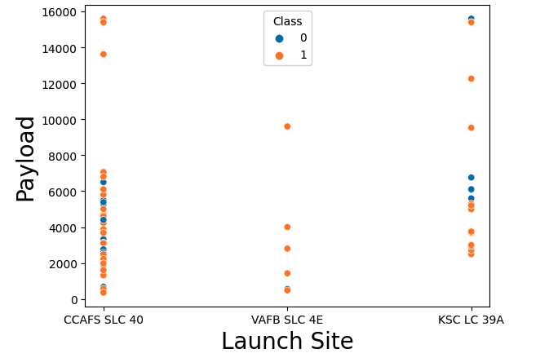
Payload vs. Launch Site
From the plot, it can be seen that Payloads between 4000 to 7500Kg have a higher failure rate than launches with lighter or higher payloads

Slide 20
Success Rate vs. Orbit Type
From the graph, it can be seen that the Orbits of ES-L1, GEO, HEO, SSO, VLEO had the most success rate.

Slide 21
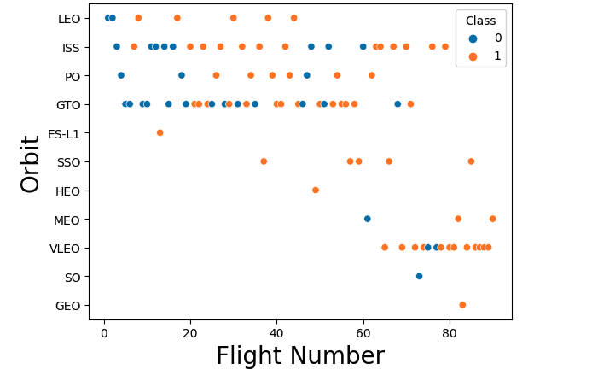
Flight Number vs. Orbit Type
From the chart, it can be seen that the Orbits of SSO and ES-L1 are not affected by Flight Number

Slide 22
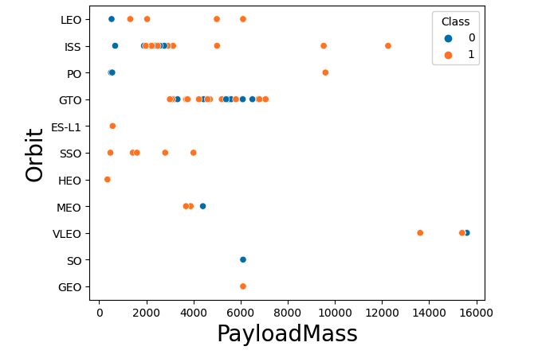
Payload vs. Orbit Type
From the plot, a heavier payload has a more successful landing in the for PO, LEO and ISS orbits.

Slide 23
Launch Success Yearly Trend
From the plot, it can be seen that success rate since 2013 has continued to increase till 2020

Slide 24
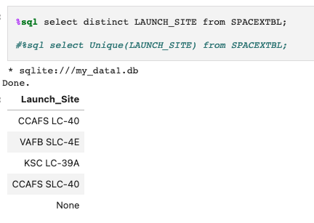
All Launch Site Names
Using the DISTINCT command through SQL we are able to filter the dataset to find each launch site

Slide 25
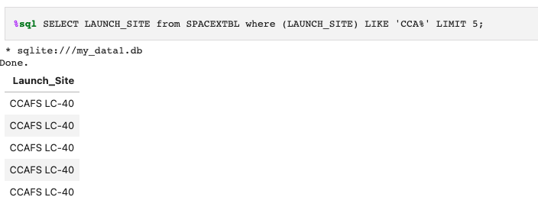
Launch Site Names Begin with 'CCA'
The SQL query is used to filter the dataset to show 5 site names

Slide 26
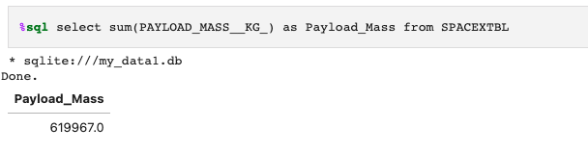
Total Payload Mass
This SQL query shows the total Payload Mass KG carried

Slide 27
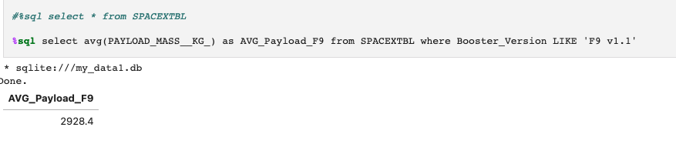
Average Payload Mass by F9 v1.1
The Average Payload of a F9 v1.1

Slide 28
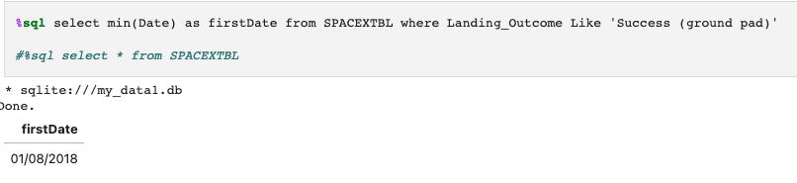
First Successful Ground Landing Date
The first Successful Ground Landing was January 8^{th, 2018}

Slide 29
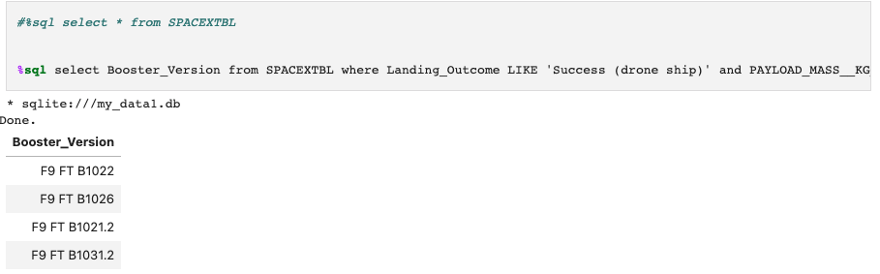
Successful Drone Ship Landing with Payload between 4000 and 6000
SQL Query below displays the Successful Payload carrying Payload between 4000 and 6000

Slide 30
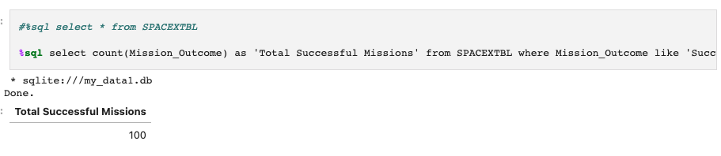
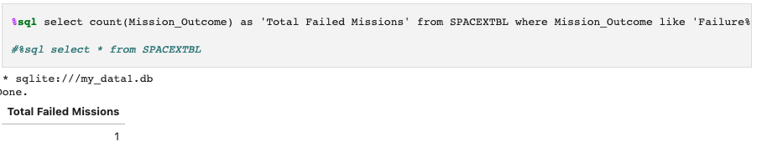
Total Number of Successful and Failure Mission Outcomes
Shows the total number of Successful and Failed Mission Outcomes

Slide 31
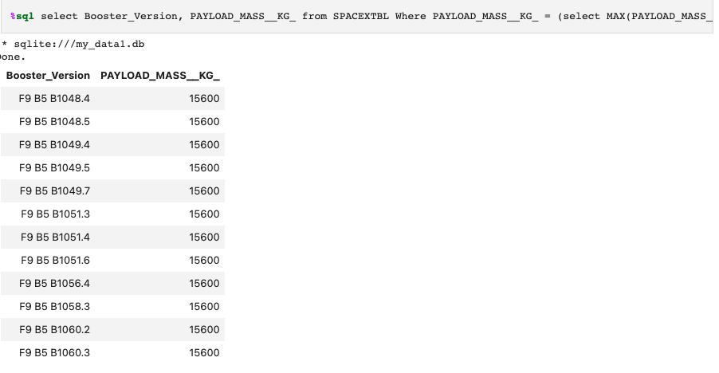
Boosters Carried Maximum Payload
Using a subquery, it can be found the Max payloads that different boosters carried

Slide 32
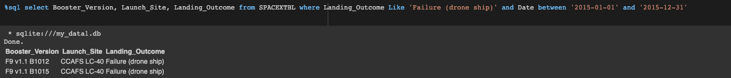
2015 Launch Records
We can see the amount of Launches Records in 2015

Slide 33
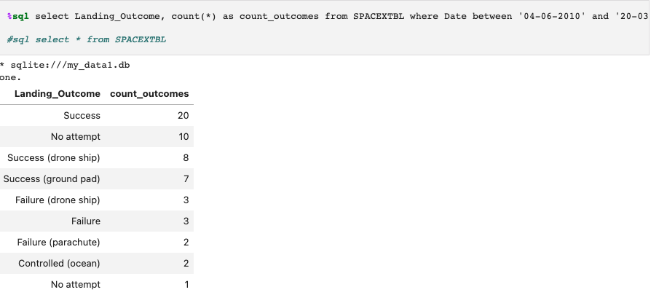
Rank Landing Outcomes Between 2010-06-04 and 2017-03-20
The total number of landing outcomes from June 4th 2010 to March 20th 2017

Slide 34

Section 3

Slide 35
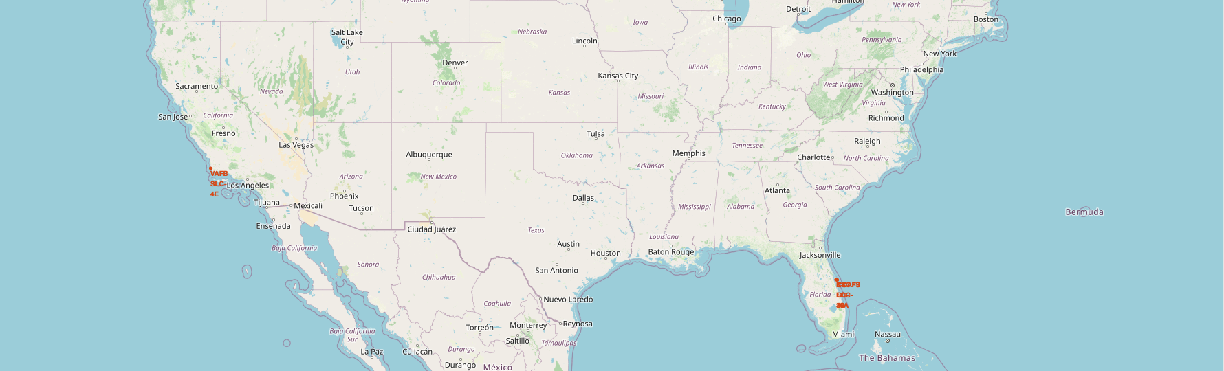
Launch Site Locations
We can see that all four launch locations are in either Florida or California

Slide 36
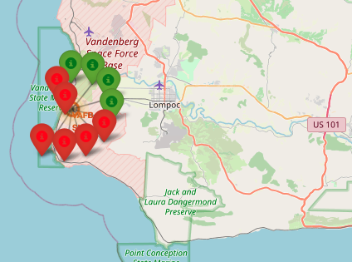
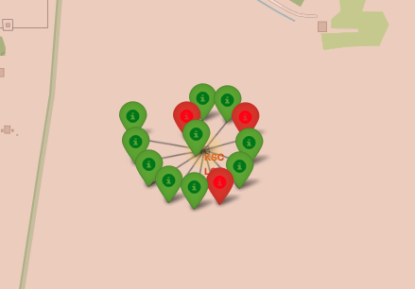
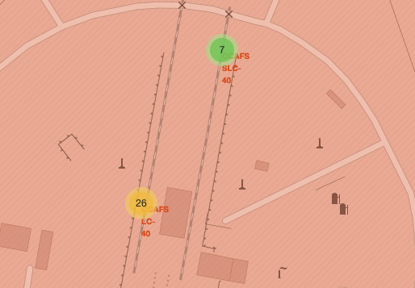
Markers showing launch sites with color labels
Green Labels show successful launches while Red show failed launches

Slide 37

Launch Site distance to Landmarks
Are Launch sites in close proximity to railways – No
Are Launch sites in close proximity to highways – No
Are Launch sites in close proximity to coastline – Yes
Are Launch sites in close proximity to Cities – No

Slide 38

Section 4

Slide 39
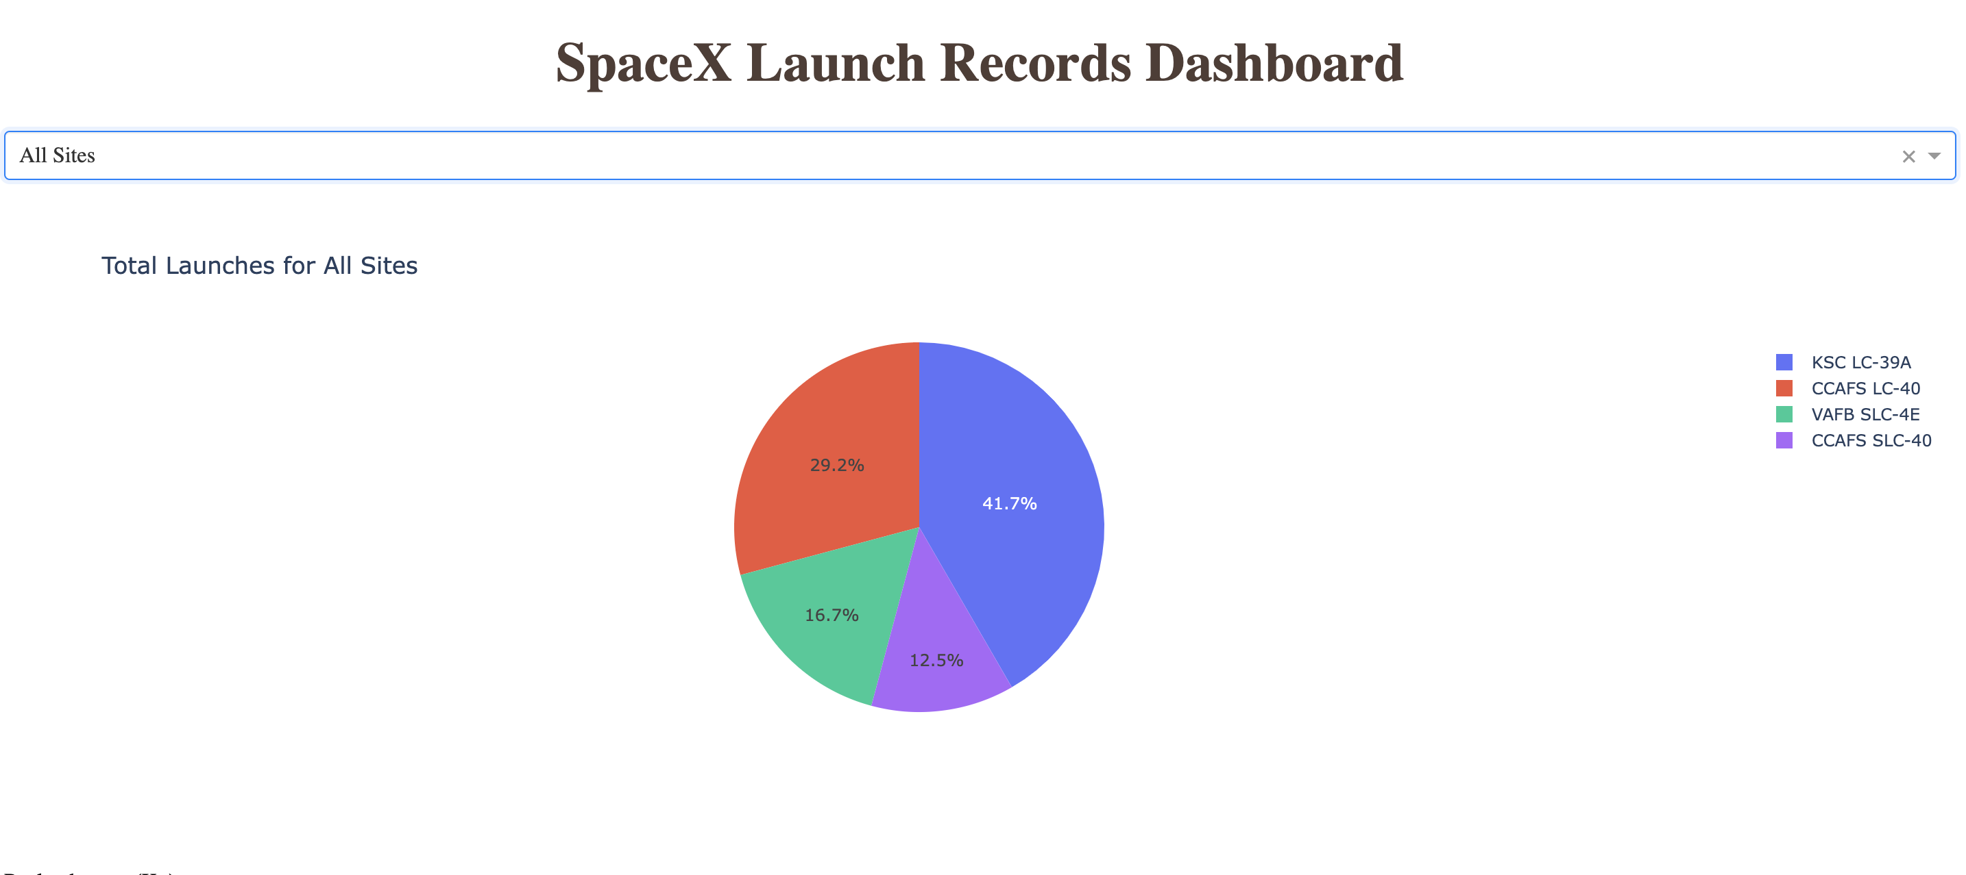
Pie Chart showing the Success percentage achieved by each launch site

Slide 40

KSC LC-39A has the Highest Success rate

Slide 41
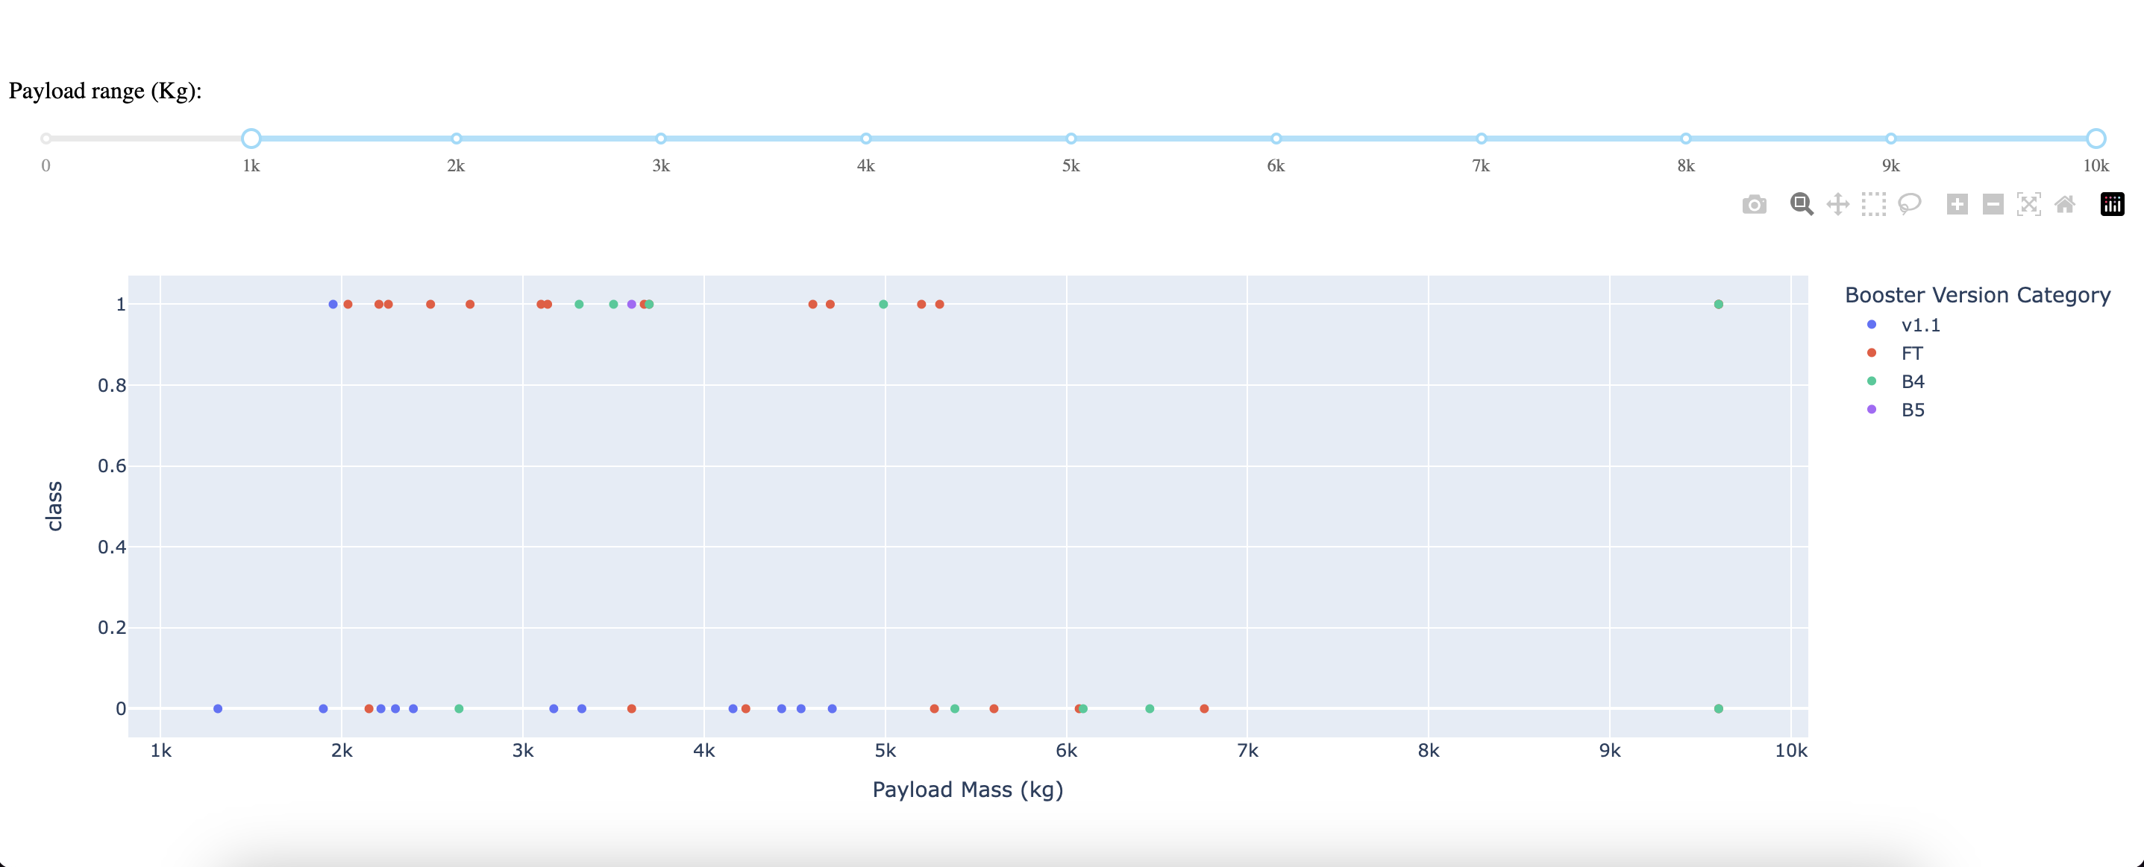
Payload Vs Launch Outcome for all Sites using Range Slider

Slide 42

Section 5

Slide 43
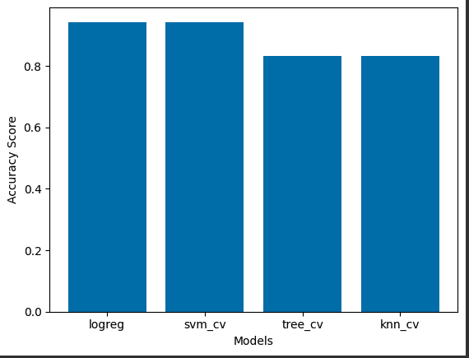
Classification Accuracy
From the bar chart, both SVM and LogReg models have the highest classification accuracy.
Both models have an accuracy score of 94%

Slide 44
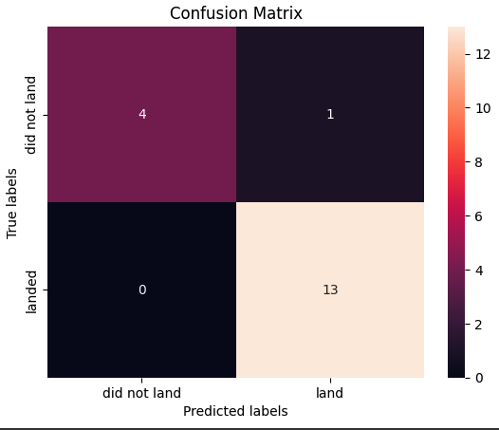
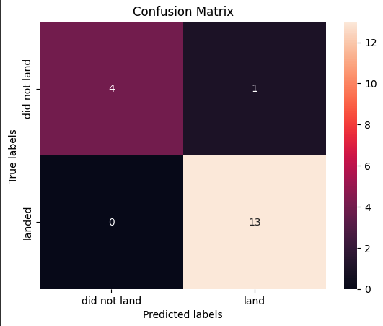
Confusion Matrix
Confusion Matrix on Left – SVM Model
Confusion Matrix on Right – LogReg Model

Slide 45
Conclusions
The larger the flight numbers at a launch site, the greater the success rate is
The Launch Success rate has continued to increase from the years 2013 to 2020
The Orbits with the highest success rates are ES-L1, GEO, HEO, SSO, VLEO
The Launch site KSC LC-39A has toe most successful launches out of all four sites
The Log Reg and SVM models are the best models to predict a successful launch

Slide 46


